Slide 1
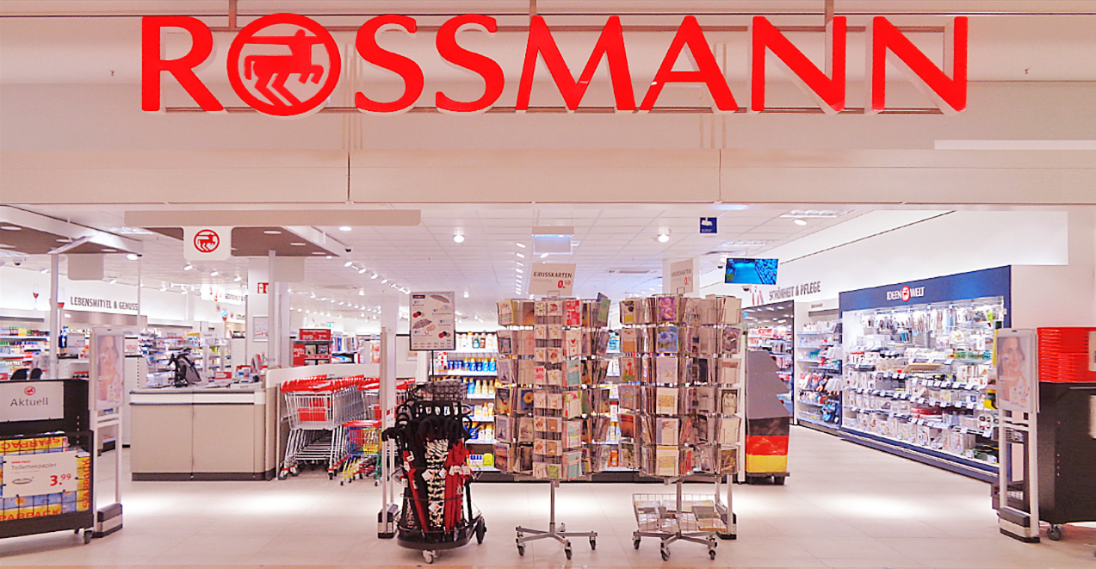
Sales Forecasting Solution for Rossmann Pharmaceuticals

Slide 2
Introduction to the Rossmann Pharmaceuticals
Rossmann Pharmaceuticals: A Leading Name in Pharmaceutical Retail
Established Reputation: Trusted for Quality Healthcare Solutions
Nationwide Presence: Operating Across Multiple Cities and Regions
Commitment to Excellence: Providing Accessible Healthcare Products and Services
Strategic Focus: Embracing Innovation to Enhance Customer Experience and Operational Efficiency
Introduction to Sales Forecasting Project: Addressing Challenges and Opportunities for Growth

Slide 3
Project overview
Project Name: Sales Forecasting Enhancement for Rossmann Pharmaceuticals
Objective: Develop and implement an advanced sales forecasting system.
Key Features: Leveraging machine learning techniques, incorporating factors such as promotions, competition, holidays, seasonality, and locality.
Goal: Accurately predict sales across all stores, six weeks in advance, to support informed decision-making by the finance team.

Slide 4
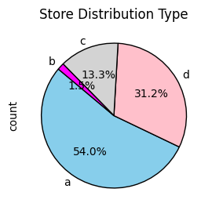
Understanding Store Type Distribution in the Pharmaceutical Business
Market Dominance: Store Type A holds majority share.
Niche Focus: Store Type B targets specialized market segments.
Market Diversity: Presence of multiple store types caters to varied customer preferences.
Growth Opportunities: Store Type D presents potential for investment and expansion.
Optimization: Performance analysis per store type aids in resource allocation and profitability.
Conclusion
Understanding store type distribution aids in strategic decision-making, ensuring market dominance, capitalizing on growth prospects, and optimizing operations within the pharmaceutical business.

Slide 5
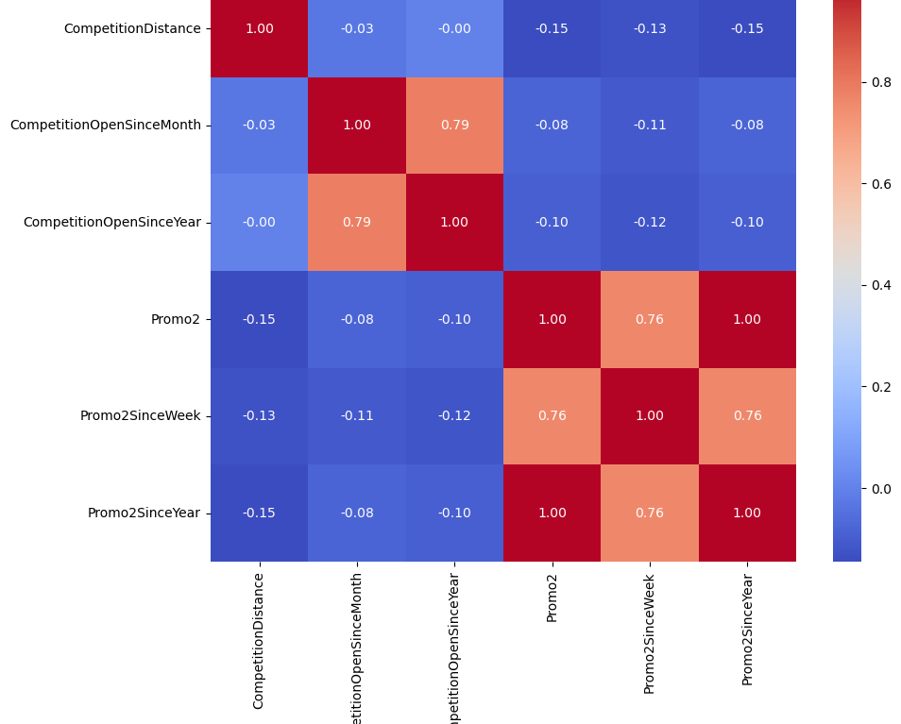
Correlation Analysis of Pharmaceutical Store Dataset
Interpretation:
Heatmap displays correlation coefficients between selected numerical variables.
Correlation ranges from -1 to 1:
1: Perfect positive correlation
-1: Perfect negative correlation
0: No correlation
Positive correlation: Both variables tend to increase.
Negative correlation: One variable increases while the other decreases.
Annotations show correlation strength.
Analysis:
Competition Open Since Month & Competition Open Since Year: Strong positive correlation (0.79), indicating stores tend to open in specific months and years together.
Promo2, Promo2SinceWeek, & Promo2SinceYear:
Strong positive correlation between Promo2 & Promo2SinceWeek (0.76), suggesting promotions tend to start around specific weeks.
Perfect positive correlation between Promo2SinceWeek & Promo2SinceYear (1.00), as they both represent Promo2 presence.
Promo2SinceWeek also correlates strongly with Promo2SinceYear (0.76), reinforcing the relationship.

Slide 6
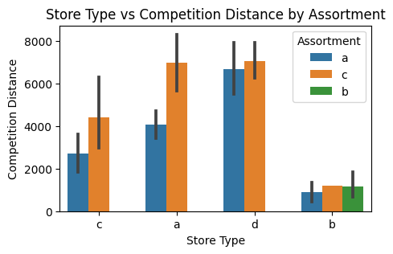
Analysis of Competition Distances Across Store Types and Assortments
Analysis
Comparison of Competition Distances Across Store Types and Assortments:
Bar plot enables comparison of average competition distances across different store types, considering assortment types.
Variation in bar heights within each store type reflects differences in average competition distances based on assortment offered.
Identification of Trends:
Relative heights of bars reveal trends in competition distances across store types and assortments.
Verification of Additional Information:
Heights of bars in the plot can cross-validate provided average competition distances for each combination of store type and assortment.
Conclusion
The bar plot provides insights into competition distance variations across store types and assortments in the pharmaceutical retail dataset, aiding strategic decisions in assortment planning, site selection, and competitive positioning.

Slide 7
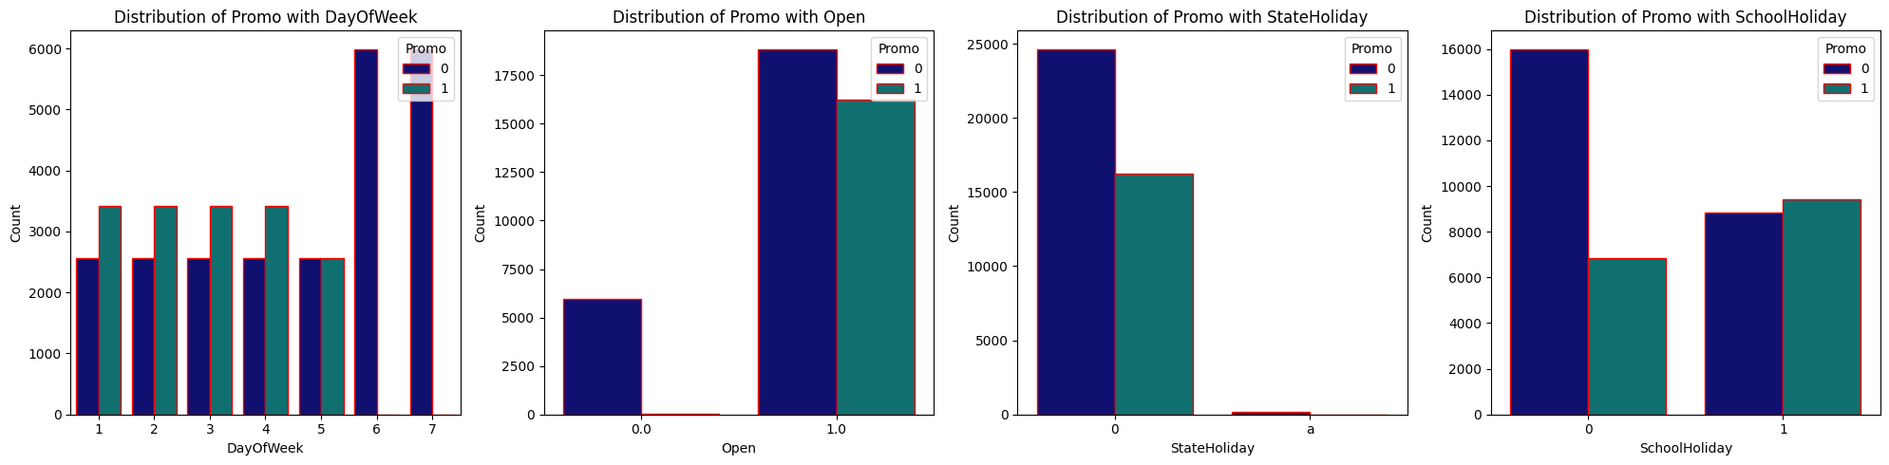
Analysis of Promo Distribution Across Different Categorical Features
Distribution of Promo with Day of Week
Across all days of the week (1 to 7), observations with "Promo" (1) consistently higher.
Days 6 and 7 (Saturday and Sunday) have a significantly higher number of observations without "Promo" (>140,000).
Distribution of Promo with Open
When the store is closed (Open=0), observations without "Promo" substantially higher.
Suggests promotional activities less common when store closed.
Distribution of Promo with State Holiday
On regular days (State Holiday=0), observations without "Promo" higher.
During public holidays, Easter, and Christmas, fewer observations without "Promo" compared to regular days.
Distribution of Promo with School Holiday
During school holidays (School Holiday=1), relatively balanced.
On non-school holidays (School Holiday=0), observations without "Promo" substantially higher.
Conclusion
Distribution of "Promo" varies across categorical features.
Weekdays see more "Promo" compared to weekends.
Fewer promotions when store closed.
Different distributions observed during holidays.
School holidays don't significantly influence promotional activities.

Slide 8
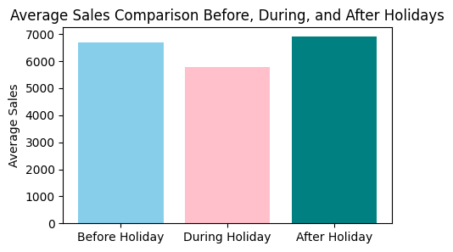
Holiday sales analysis
Before Holiday: Average sales range between 6000 and 7000, indicating heightened consumer spending in anticipation of the holiday. Customers tend to stock up on supplies or take advantage of pre-holiday sales.
During Holiday: Average sales range from 5000 to 6000, suggesting a slight decrease compared to pre-holiday sales. Altered shopping behaviours during holidays, such as prioritizing family time or holiday activities, may contribute to this dip.
After Holiday: Average sales rebound to 7000, indicating a return to normal shopping routines or uptake in post-holiday sales and promotions.
Conclusion: The analysis reveals a typical consumer behaviour pattern surrounding holidays: increased pre-holiday spending, a slight dip during the holiday, and a post-holiday sales surge. Retailers can leverage this insight to adjust marketing strategies and inventory management, optimizing sales and meeting customer demand e

Slide 9
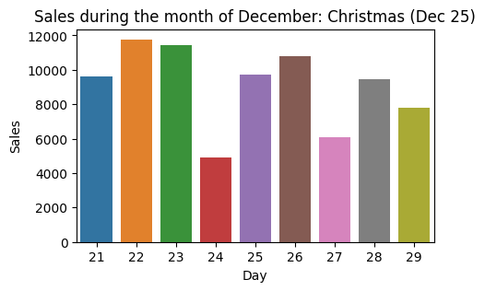
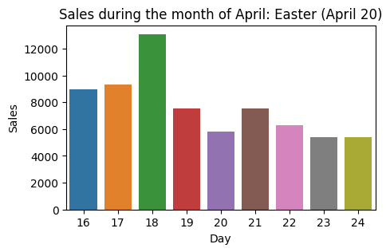

Slide 10
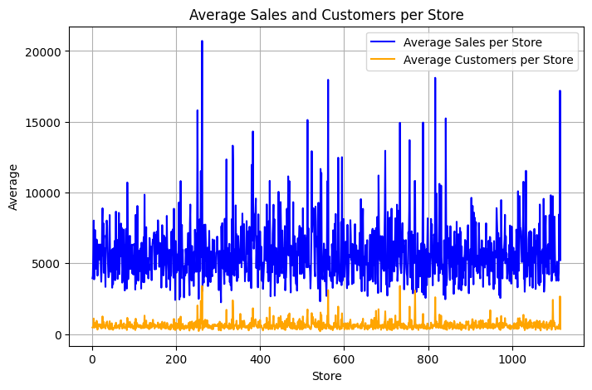
Store performance analysis
Average Sales per Store: The blue line illustrates the average sales per store, revealing variations across different store indices. Stores around index 250-300 exhibit a significant spike in average sales, peaking at approximately 40,000. Other notable spikes occur around indices 550, 810, and 1150, with average sales ranging between 17,500 to 18,000.
Average Customers per Store: The orange line showcases the average number of customers per store. Similar to average sales, certain stores demonstrate higher average customer counts. Stores around index 250-300 show a peak in average customer count, reaching up to approximately 4000. Additionally, stores around index 550 and 700-800 also exhibit higher average customer counts.
Comparative Analysis
By comparing the trends of average sales and average customers per store, it's evident that a correlation exists between the two metrics. Stores with higher average sales tend to attract more customers on average.

Slide 11
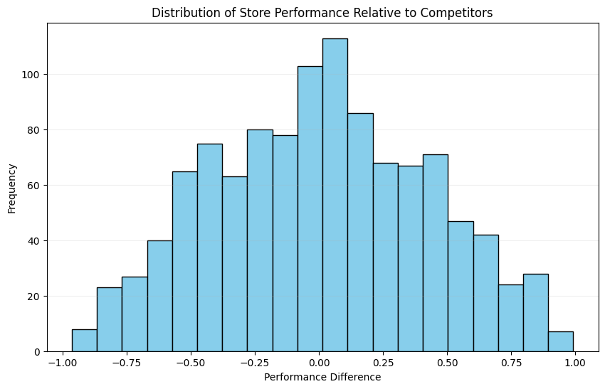
Analyzing Store Performance Relative to Competitors: Insights and Implications
Analysis:
Store Performance: The histogram displays performance disparities between stores and their competitors.
Frequency Distribution: Peak frequency occurs around a performance difference of 0, indicating similar performance to competitors.
Implications for Strategy: Positive differences suggest competitive advantages, while negative differences indicate areas for improvement.
Benchmarking and Analysis: Comparative analysis aids in benchmarking and identifying improvement opportunities.
Conclusion:
The histogram effectively illustrates store performance, guiding strategic decisions.
Analysis facilitates leveraging strengths and addressing weaknesses.
Continuous monitoring fosters sustained competitive advantage.

Slide 12
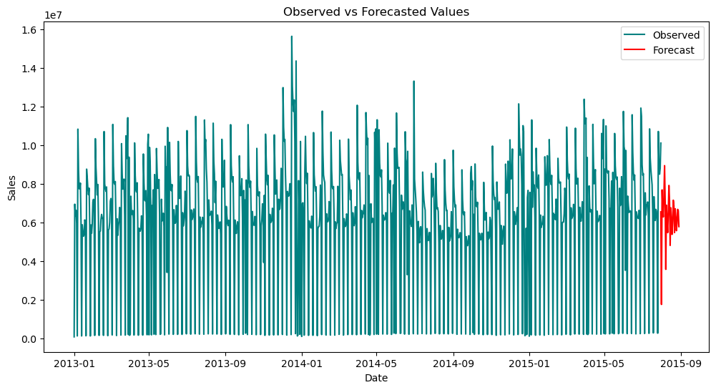
arima model forecast analysis
Interpretation
Actual Sales (Teal Line): Represents observed sales data up to the present time, with the latest data point at the end of the time series.
Forecasted Sales (Red Line): Shows forecasted sales values for the next 42 days, starting August 2015, generated by the ARIMA(7, 0, 0) model based on historical sales data.
Analysis
January 2014 Sales: Significantly higher compared to other months and years, potentially due to seasonality, promotions, or external factors.
Forecasted Sales for August 2015: Depicted by the red line, accuracy relies on the ARIMA model's reliability and continuity of underlying data patterns.
Comparison of Actuals and Forecast: Allows assessment of the model's predictive performance and identification of areas for improvement or external influences on sales.
Conclusion
Visual comparison aids in evaluating model performance.
January 2014 sales spike suggests unique factors influencing sales.
Interpret forecasts cautiously, considering potential uncertainties and external influences. Further model refinement may enhance accuracy.

Slide 13
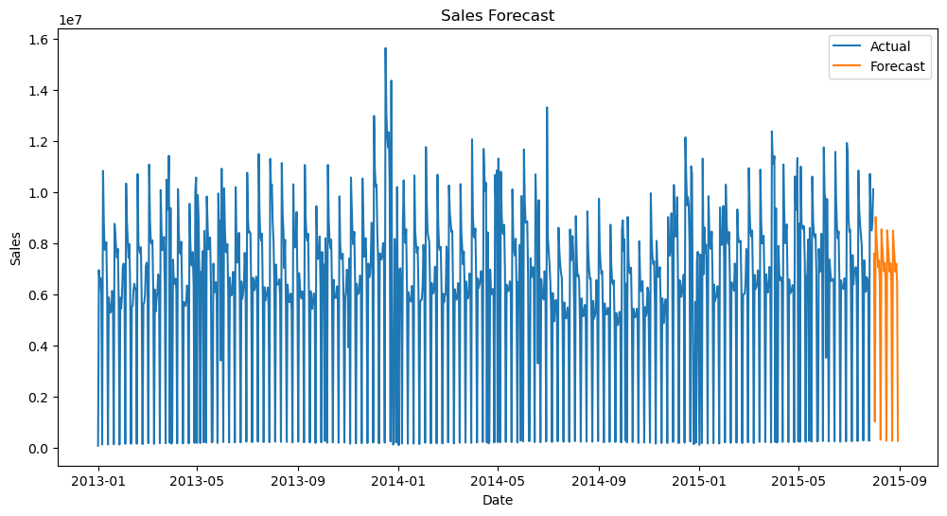
sarima model forecast analysis
Interpretation
The SARIMA model generates a forecast for sales data, projecting trends into the future period from the end of available data. A 42 -step forecast is made in this instance.
Analysis
The forecasted values are plotted against actual sales data, visualizing the projected trend.
SARIMA model captures historical patterns, reflected in the alignment of forecasted values with actual sales data.
Forecasted values exhibit uncertainty, depicted by the provided range for forecasted sales values.
Conclusion
SARIMA model aids in forecasting future sales based on historical data patterns.
Forecasted values offer insights for planning and decision-making.
Consider uncertainty in forecasted values for robust decision-making. Further analysis and validation enhance forecast reliability

Slide 14
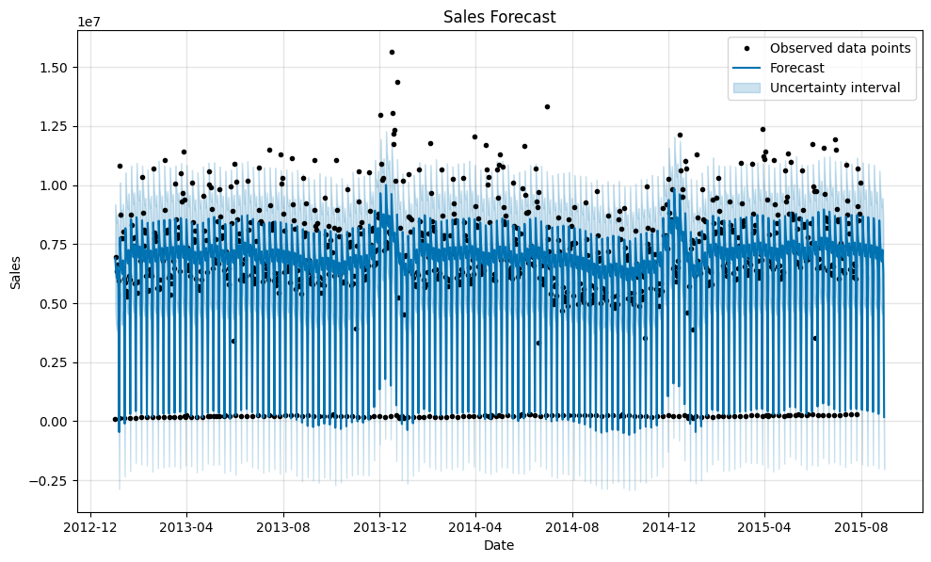
Prophet model forecast analysis
Interpretation
The Prophet model generates forecasts for future sales data, plotting forecasted values and uncertainty intervals against observed data points. Black dots represent observed data, the blue line depicts forecasted values, and sky-blue bars signify uncertainty intervals.
Analysis
Observed Data Points: Black dots represent actual sales data observed over time.
Forecasted Values: Blue line displays forecasted sales values generated by the Prophet model for future time periods, indicating expected sales trends.
Uncertainty Intervals: Sky-blue bars around forecasted values represent uncertainty intervals, indicating the range within which actual sales values are likely to fall with confidence levels. Wider intervals imply higher uncertainty.
Model Performance: Visual inspection assesses how well the Prophet model captures underlying patterns and dynamics in sales data, with good model fit evidenced by close alignment between forecasted values and observed data points, and uncertainty intervals capturing data variability.
Conclusion
Prophet model-generated plot offers insights into forecasted sales trends and uncertainty estimates.
Observations, forecasts, and uncertainty intervals contribute to comprehensive understanding of future sales behavior.
Further analysis, including accuracy assessment and investigation of deviations, validates Prophet model performance for reliable decision-making.

Slide 15
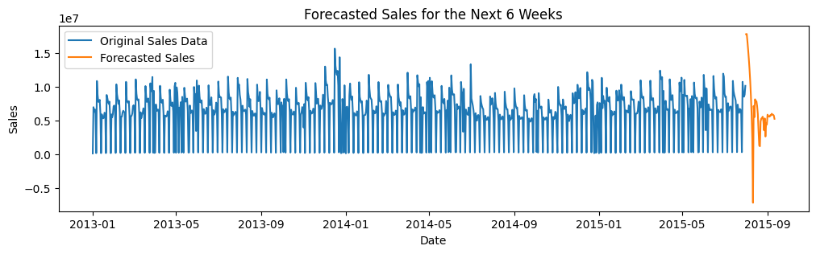
Lstm model Forecasted Sales Trends: Insights for the Next 6 Weeks
The plot illustrates the forecasted sales for the next 6 weeks based on historical sales data. The original sales data, represented by the blue line, shows past sales trends, while the forecasted sales, depicted by the orange line, indicate projected sales for the upcoming weeks. The forecast provides valuable insights for business planning and decision-making, allowing stakeholders to anticipate future sales trends and adjust strategies accordingly.

Slide 16
rossmann sales forecasting solution
End-to-End Solution: Developed comprehensive solution for sales forecasting across Rossmann Pharmaceuticals' multiple stores.
Key Features: Utilized machine learning techniques incorporating promotions, competition, holidays, seasonality, and locality.
Accurate Forecasts: Delivered predictions six weeks in advance, empowering finance team with data-driven insights.
Reduced Reliance on Judgments: Automated forecasting process reduces subjective judgments, ensuring objective decision-making.
Scalability: Solution adapts to new data inputs and store configurations, ensuring relevance over time.
Continuous Monitoring: Implementation of monitoring and evaluation mechanisms for refining model's performance.
Enhanced Usability: Implemented Flask application with user-friendly dashboard for easy data input and visualization of sales trends.
Downloadable Predictions: Users can download prediction data for further analysis and integration into workflows.
Empowering Rossmann: Equips Rossmann Pharmaceuticals with actionable insights for optimizing resource allocation and maximizing revenue.

Slide 17
Thank You!

